Slide 1
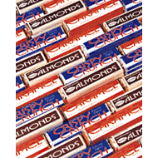
Anthony Thomas Chocolate Fundraiser

Slide 2
WHY??
Why do we even need another fundraiser? Troop 16 already offers the popcorn sale and occasional car washes.
Scouts are busy during the fall and may not be able to sell the amount of popcorn they need to sell in order to make enough money into their scout accounts.
Sports, Leadership positions, and Academics

Slide 3
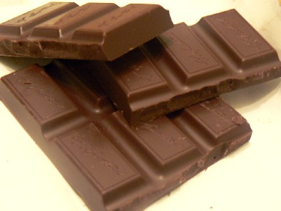
Purpose
This fundraiser in no way is supposed to replace the popcorn sale.
Provide boys with another (not alternative) opportunity to make money into their scout account.
Teaches boys about salesmanship skills

Slide 4
About
The Nectar Candy Co. (distributor of local candy Columbus maker, Anthony Thomas) has been providing countless non-profit organizations with the finest quality chocolates available in the fund raising industry since 1960.
All candy bars are wrapped in custom imprinted Anthony-Thomas "Made for Fund Raising" label.

Slide 5
The Candy Bar
Four Varieties are available:
Crisped Rice
Roasted Almonds
Soft Caramel
Peanut Butter
Packaged one kind per case/ 180 candy bars packaged in six E-Z plastic carrying bags within the case.

Slide 6
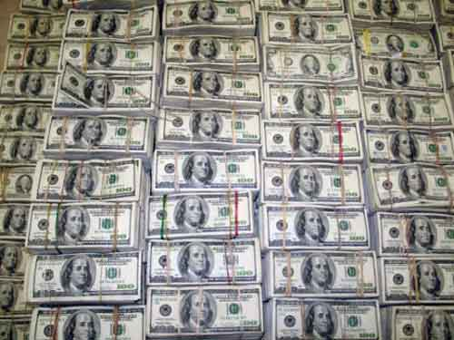
Money
Anthony Thomas gives 50% back.
Each candy bar is priced at $1
I propose the scout would get all of the proceeds from the money being made
$0.50 from each candy bar being sold

Slide 7
Calculations
Average Camping trip ($14)…………. 28 bars
Expensive Camp out ($50)…………… 100 bars
Yearly dues ($50) or ($100) 100 or 200 bars
Summer Camp ($230)…………………. 460 bars
Philmont ($2,000)…………………….. 4,000 bars

Slide 8
Downsides
The scout would have to pay up front for the bars.
Each case is 180 candy bars (no mixing varieties)
The scout only makes $0.50 for each candy bar sold
Competition among other fundraisers

Slide 9
Solutions
If the scout says he is going to sell ___ amount of candy then he’s going to sell that much.
Scouts can team up with other scouts
i.e. Jim will sell 90 bars and Dylan will sell 90 bars
The bars sell like wild fire and people will always buy chocolate (especially from cute boy scouts like myself).
We’re not going to be competing against Pack 36 or Troop 28

Slide 10
Options
Scout
Show and Deliver
Order Forms

Slide 11
Show and Deliver
The scout says he will sell ____ much and gives the troop ___ much.
The troop orders it and gives him the candy bars.
He sells them
Scout gets reimbursed (50% of the money turned in)
Scout gets money in his scout account (50% of the money turned in)

Slide 12
Order Form
Same idea as popcorn
The scout fills out the order form
He turns in the form
Troop orders it
The scout delivers it

Slide 13
Questions

